Slide 1
Welcome!

Slide 2
The webinar will begin shortly…
3:00
minutes
until the webinar starts
While you wait, here are some fast facts about HR outsourcing:
Companies that outsource HR to a professional employer organization (PEO) are 50% less likely to go out of business.
“Professional Employer Organizations: Keeping Turnover Low & Survival High” McBassi & Company, 2014

Slide 3
The webinar will begin shortly…
2:00
minutes
until the webinar starts
While you wait, here are some fast facts about HR outsourcing:
Companies that use a professional employer organization (PEO) are 28% more satisfied with their available selection of employee benefits.
“PEOs: Taking Outsourcing a Step Beyond Pays off for Small & Mid-Sized Companies” Aberdeen Group, 2011

Slide 4
The webinar will begin shortly…
1:00
minute
until the webinar starts
While you wait, here are some fast facts about HR outsourcing:
G&A Partners has an average Net Promoter Score (NPS) that is 35x higher than that of the HR outsourcing industry.
“NPS Benchmarks for B2B” Inavero, 2014

Slide 5
Before we begin…
We are recording this webinar. The on-demand recording will be available on our website by the end of the week.
This webinar has been pre-certified by the Human Resources Certification Institute (HRCI) and The Society for Human Resource Management (SHRM) for one hour of HR general recertification credit.
If at any time during the presentation you have a question that you’d like us to answer, please send it to us using the “Questions” tab in the GoToWebinar menu bar.

Slide 6
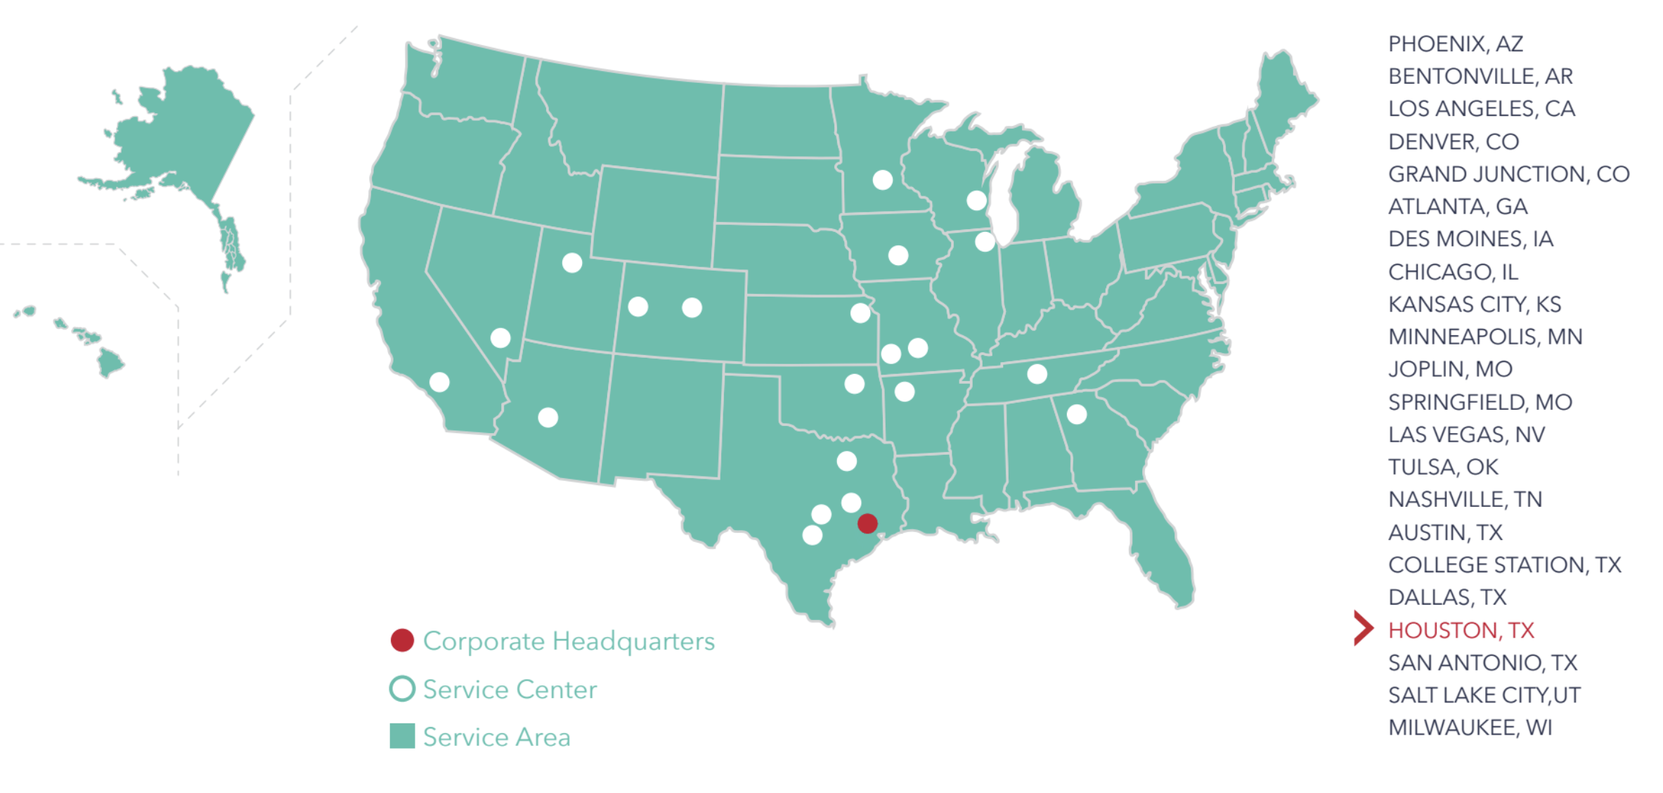
About G&A Partners
G&A Partners delivers world-class HR solutions that help build thriving businesses and make a difference in the lives of the clients and employees we serve.

Slide 7
Prioritizing Diversity In Your Organization

Slide 8
Poll Question
The Bottom Line
Racially and ethnically diverse companies have a ___% higher likelihood of financially outperforming less diverse companies.
22%
36%
43%
Why do you think diverse companies outperform other businesses.
Notes:
36%
Source: blog.clearcompany.com

Slide 9
Poll Question
We Want You
____% of employees and job seekers said diversity was important when considering job offers.
45%
64%
76%
Did you consider diversity when you last interviewed?
Source: blog.clearcompany.com
Notes:
Now for our second poll question. What percentage of employees and job seekers said diversity was important when considering job offers? Is it 45%, 64% or 76%. If you guessed 76% you are correct! As diversity, equity and inclusion become a larger cultural topic of conversation, naturally that is going to trickle into the professional environment and more and more candidates are going to start asking those questions as they consider your business for the next opportunity. This is a really important piece of data for you and your hiring managers to consider as you look to set your company apart from the competition.

Slide 10
Today’s Learning Objectives
You’ll Learn
What exactly is diversity and what does it mean
How can companies fairly, yet intentionally, implement recruitment strategies that ensure a diverse workforce
What’s in it for me, how does it benefit my business
What’s in it for me, how does it benefit employees
How to embed diversity into your company culture – strategies to help you get started
Notes:
Michelle’s slide

Slide 11
What exactly is diversity and what does it mean?
Notes:
Thanks Michelle, I’ll kick us off with our first learning objective. So what exactly is diversity? Let’s explore the definition and then move into some thoughtful approaches on how to think about diversity as you expand your workforce.

Slide 12
By Definition
Diversity
The ways we are different; the condition of having unique characteristics. The condition of being diverse:
Variety; especially the inclusion of diverse people (as people of different races or cultures) in a group or organization.
Diversity is the range of human differences, including but not limited to race, ethnicity, gender, gender identity, sexual orientation, age, social class, physical ability or attributes, religious or ethical values system, national origin, and political beliefs.
Can you think of
one initiative that your company has implemented to support diversity?
Notes:
In its simplest terms diversity is that ways we are different. There can be some vary obvious ways that we see diversity, such as physical attributes or a physical disability. But there can also be less obvious ways that we see diversity, whether it be religion, a non-physical handicap or even an employee’s talents. It’s important to train your leadership to think of diversity in a larger context so

Slide 13
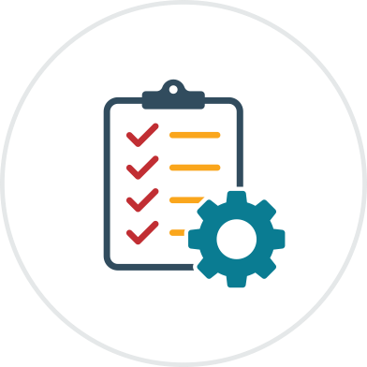
Thoughtful Approach
Recruitment Strategies: Fair and Intentional
Create clear, inclusive and focused job postings : Use the less is more approach.
Forego fluff in job titles and opt for clarity instead
Eliminate confusing language; focus on outcomes
Briefly highlight your company’s onboarding plan
Share your company’s diversity policy
Be transparent—include information about work-life balance, compensation, and other important information
“Think about the candidate experience – If they are reading your job ad from a smart device, what information do you want them to see first?”
Notes:
Michelle slide

Slide 14
Thoughtful Approach
Recruitment Strategies: Fair and Intentional
Create A Strategic Diverse Referral Program
Evaluate all applicants, including employee referrals, using the same qualification criteria. If employee referrals immediately go to the top of the list, they may be receiving preferential treatment that undermines diversity.
Track your talent channels to determine if applicants and hires from each channel tend to belong to a particular demographic. If referrals are mostly white males, for instance, how can other channels attracting women or minority applicants be invested in?
Ensure employee referral programs are open to the entire organization and not limited to specific groups of employees, departments or even divisions.
Does your company have an employee referral program?
https://www.shrm.org/resourcesandtools/tools-and-samples/hr-qa/pages/do-employee-referral-programs-negatively-affect-diversity-in-the-workplace.aspx
Notes:
Thanks Michelle for those ideas! Recruiting can be quite the challenge these days. The second strategy I want you to think about is your Employee Referral program. Do you have one? Employee referral programs can be a really effective way to source new talent. Through a monetary reward you essentially turn your employees into recruiters. Almost every company I have ever worked for had an employee referral program. Here’s the challenge with employee referral programs…employees tend to recommend those who look like them, who think like them and are very similar to them. So it’s important the you create an employee referral program that is more thoughtful. On this slide you can see a few examples of how to achieve that. READ SLIDE

Slide 15
Thoughtful Approach
Recruitment Strategies: Fair and Intentional
3. Utilize focused job boards and networking events to enhance your candidate pool
“Do you know which job boards are focused or specific to your industry?”
“Has your company or its hiring managers participated in networking events as part of the recruiting process?
Notes:
Michelle slide

Slide 16
Thoughtful Approach
Recruitment Strategies: Fair and Intentional
Share your Culture with Candidates
Include a culture statement in your job ads
Create a culture statement that is concise, accurate and compelling
Discuss the company’s culture during the interview process and encourage hiring managers to do the same
Does your company have a culture statement?
Notes:
As we saw in the second poll question, 76% of candidates value culture as a criteria for searching for a new job. If you’ve spent time recruiting you know that companies tend to focus on their competitive compensation or their generous benefits offering, but it’s also important to showcase your culture. A culture state encompasses what you value, what you believe and can also include pieces of your mission, vision and values. This simple statements sets the standard for what candidates can expect when they come to your company and the standard you have for them when joining. I recently sat in on some interviews and the recruiter told the candidate while many companies say their company values are important we truly walk the walk. The recruiter then went on to give an example of how even the CEO demonstrates being humble (which was one of their core values) and then next asked the candidate can you give me an example of a time when you did something at work that would reflect our core values. And I thought what a great line of questioning! It went so far beyond the basic “can you work excel?”

Slide 17
Thoughtful Approach
Recruitment Strategies: Fair and Intentional
5. Use AI or a candidate peer/panel review process that promotes a bias free screening process
“Have you ever read a name on a resume and instantly made assumptions about a candidate?”
“Have you seen information included on a resume that could have contributed to an unconscious bias?”
Notes:
Michelle slide

Slide 18
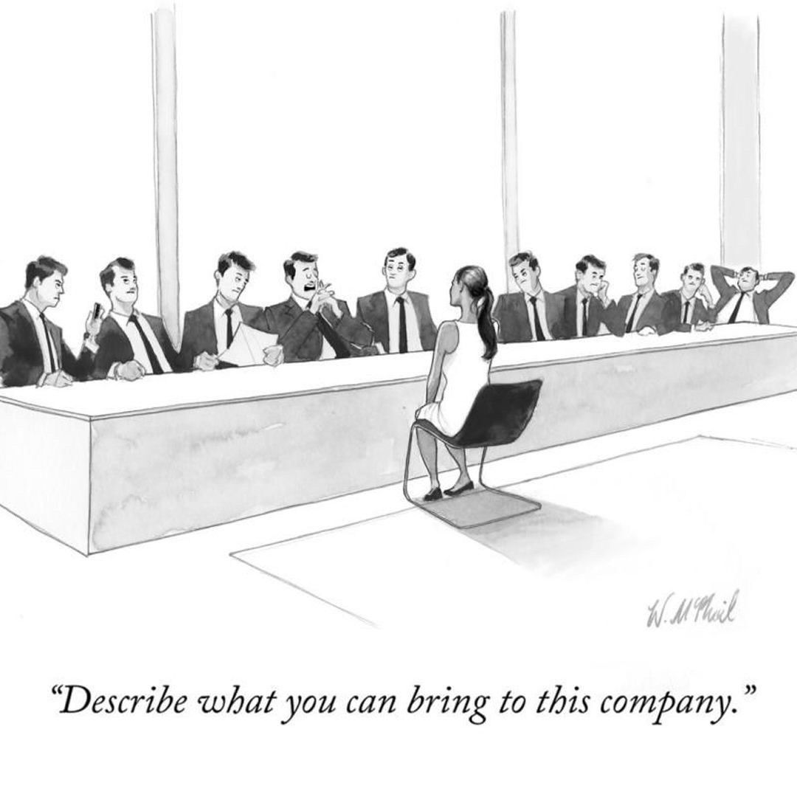
Thoughtful Approach
Recruitment Strategies: Fair and Intentional
Include Diverse Individuals in your Screening Process
Add a peer, subordinate or another hiring manager
Work with the panel to develop their questions so each person asks a variety of questions
Helps foster allyship
“How many individuals are involved in your company’s interview process?”
Notes:
It’s really amazing the technology and best practices available to help ensure that our job postings and interview process are unbiased. But I want to suggest another idea. Think about who you have as part of the interview process. Do you only have the hiring manager doing the interview? Do they represent your entire workforce? If not, consider adding someone else to the mix to get a different perspective. A former boss of mine asked the same question in every interview he did and I have stolen that idea from him. He would ask “Who are you outside of work?” I love that question because it gives you insight into the candidate that you may not glean from their resume or their technical experience.

Slide 19
Thoughtful Approach
Recruitment Strategies: Fair and Intentional
7. If utilizing a pre-employment assessment tool such as a DISC, job knowledge, personality or skills assessment, ensure consistent application of the tool (provide to all relevant applicants for a specific role, at the same interval in the hiring process)
“Does your company utilize a pre-employment assessment tool?”
If so, use the chat feature to share the type of tool being used.
Notes:
Michelle slide

Slide 20
Poll Question
Survey Statistics
In thinking about an employee referral program, applicants who applied from a referral were ___times more likely to be hired than an applicant from a job board.
6%
10%
18%
https://www.careerplug.com/blog/hiring-statistics/
Notes:
Time for another poll question! READ Question. Is the answer 6%, 10% or 18%. And the answer is 18%. Think about that for a minute…that’s not an insignificant number which is why it’s so important that that 18% represents a diverse group of people. Michelle will now ask our fourth and final poll question.

Slide 21
Poll Question
Survey Statistics
In thinking about sharing insight into your company’s culture in your job ads, consider this: ____% of people would consider a company’s culture before applying for a job there.
56%
67%
77%
Source: https://www.careerplug.com/blog/hiring-statistics/
Notes:
Michelle slide
Source: https://www.careerplug.com/blog/hiring-statistics/
77%

Slide 22
What’s in it for me, how does it benefit my business?
Notes:
In order to be successful every business needs to make a profit or bring in revenue or reach a certain level when selling a product or service, so as you think about diversity we want to share with you how it benefits your business. As well all know, if you are going to invest dollars or time to an initiative you want to see that return on investment. This may especially be important when you are selling the idea of diversity to your senior or executive leadership.

Slide 23
Benefits for the Business
48 percent of Generation Z are racial or ethnic minorities
Diverse companies enjoy 2.3 times higher cash flow per employee
Diverse management has been shown to increase revenue by 19 percent
Builtin.com
Notes:
Here are some statistics highlighting why diversity is good for business. Diversity is essential to business growth and prosperity; drives innovation and results in better performance among teams. With 48% of Gen Z individuals being a racial or ethnic minority you have so much exciting diversity at your finger tips. This generation can bring a different perspective to your company from the start. Additionally, your efforts come full circle, the more you invest in diversity the easier it becomes to attract and retain top diverse talent.
Why do you think diverse companies have higher cash flow or increase revenue? It’s because you have a more diverse pool to gain ideas from on how to problem solve or how to sell.
Compliance and shareholder pressure
Social responsibility

Slide 24
Benefits for the Business
Gender-diverse companies are 15 percent more likely to beat industry median financial returns
More than 3 out of 4 workers prefer working at diverse companies
Notes:
Michelle
Source: Builtin.com

Slide 25
Benefits for the Employees
Best Practice
More promotional opportunities, while always ensuring to select the most qualified candidate(s)
Diverse teams make better decisions than non-diverse team up to 87% of the time, according to one study
Employees feel valued
https://www.cloverpop.com/hacking-diversity-with-inclusive-decision-making-white-paper?utm_campaign=Forbes&utm_source=Forbes&utm_medium=Forbes%20Hacking%20Diversity%20White%20Paper
Notes:
Investing in diversity is good for business, but it also benefits your employees. The most obvious reward is that employees feel valued and when employees feel valued they take less sick days, they are more productive, and they are more likely to talk positively about their work environment. Diversity also results in better decisions. Why is that? Well think of it this way. If you only have big picture thinkers on your team, who’s going to think about the details?

Slide 26
Benefits for the Employees
Best Practice
Reduced turnover which helps stabilize workloads
Higher employee engagement
Notes:
Michelle
Source:
Bullet #2 https://www.cloverpop.com/hacking-diversity-with-inclusive-decision-making-white-paper?utm_campaign=Forbes&utm_source=Forbes&utm_medium=Forbes%20Hacking%20Diversity%20White%20Paper

Slide 27
Embedding diversity into your company’s culture
Notes:
I hope we’ve provided you with a lot of food for thought today. Diversity may seem overwhelming to you so I want to recap some of those best practices mentioned to help give you a roadmap.

Slide 28
Getting Started: Diversity and Culture
Best Practices
Adjust how you screen and search for candidates
Hold executive leaders accountable for driving D&I outcomes
Center diversity and inclusion in the business strategy
Create an ERG (Employee Resource Group) or focus group dedicated to diversity initiatives
Educate your workforce on your company’s diversity initiatives
Pivot from diversity training for leaders to leadership development coaching
Notes:
The first is to start with your process for searching for and bringing on new talent. Second, get your leaders involved and hold them accountable. Talk to them about including D, E and I efforts in their strategy meetings. Create an employee resource group so you can hear directly from your employees as to what’s missing or how are they feeling about things that are going well and things that are not. And finally think about shift from diversity training to coaching. Coaching helps leaders continue to pass along that message to their direct reports.

Slide 29
Getting Started: Diversity and Culture
Time to take action
Review your job postings
Assess your interviewing processes and team
Establish an employee referral program
Research which focused job boards are right for your business and include them in your recruiting strategies
Create a culture statement or core values and ensure they are alive in your organization
Notes:
Michelle

Slide 30
Bringing it All Together
Notes:
As we wrap up this webinar we want to bring it all together and leave you with some final best practices so you can begin to think of how to implement these strategies in your own organization.

Slide 31
In a Nutshell
Ensuring diversity is embedded into your culture requires intention.
It starts at the top.
Ensure diversity initiatives are part of your strategic planning
Track your diversity initiatives, measure the effectiveness of each and pivot if something is not achieving the desired result
Hold your leaders accountable for results
Showcase your company’s diversity efforts not only with your employees, but also in your recruiting
Acknowledge recruiting biases and implement strategies to address
Lead, coach and train your leadership team!
Notes:
Diversity doesn’t just happen automatically, it requires intention and the first place it starts is at the top! We have listed out 6 best practices for you to consider for your business.
If you have a seat at the table when you start your strategic planning for 2023, bring up diversity and suggest a few initiatives that you would like to see included in that plan.
Track your initiatives and pivot if needed. If you track your efforts and see positive change-showcase that with your employees!
Hold your leaders accountable
As I said in #2 make sure you showcase those efforts and achievements.

Slide 32
Questions
You can type questions for our presenter in the chat pane of your Go-to-Webinar menu bar.
If we don’t get to your questions during the Q&A session of this presentation, you can email them to info@gnapartners.com.
Notes:
Thank you, Lisa and Kelley. As I said at the beginning of our presentation, attendees can type questions for our panel on the right side of the page in the GoToWebinar menu bar. We’ll give everyone about 30 seconds to submit your questions and return for the Q&A session…
CHRIS: 00:47 – Review questions submitted by the attendees (if any). Wait about 30 seconds.
CHRIS: Ask canned questions first..
Q&A SESSION BEGINS, FACILITATED BY THE ORGANIZER.
CHRIS: Alright, we have received our first question, “If my state has a PFL law, does my employer have to give me leave?”
(PAUSE)
CHRIS: Our next question asks, “Will I have to provide a posting or notice for my employees?”
(PAUSE)
CHRIS: Thank you, someone else asked, “Does PFL apply to caretakers?”
(PAUSE)
Chris: Looks like we have time for one more; someone asked “What’s the difference between family leave, maternity leave, and paternity leave?”

Slide 33
Resources
For additional resources, including our on-demand webinars, visit: gnapartners.com/resources

