Slide 1
Workplace Violence Prevention in California
©2024 BLR®, a division of Simplify Compliance LLC
XXXX

Slide 2
About This Module
OVERVIEW
LEARNING
OBJECTIVES
Workplace violence is among the top leading causes of workplace fatalities, and there are thousands of nonfatal violent on-the-job incidents each year. Workplace violence can occur at any business or workplace, and anyone can be a victim. Therefore, it’s important for you to know how to prevent these incidents and what to do if you encounter a potentially violent situation at work.
This session also covers our workplace violence prevention plan, how to report incidents, the workplace violence hazards of your job, and information about the violent incident log.
Notes:
Workplace violence is among the top leading causes of workplace fatalities, and there are thousands of nonfatal violent on-the-job incidents each year. Workplace violence can occur at any business or workplace, and anyone can be a victim. Therefore, it’s important for you to know how to prevent these incidents and what to do if you encounter a potentially violent situation at work.
This session also covers our workplace violence prevention plan, how to report incidents, the workplace violence hazards of your job, and information about the violent incident log.

Slide 3
About This Module
OVERVIEW
LEARNING
OBJECTIVES
At the completion of this module, the participant will be able to:
Describe the four types of workplace violence
Identify workplace violence risk factors
Recall engineering and administrative controls
Recognize the signs of potential violence
Defuse potentially violent situations safely
Respond appropriately to a violent incident
Notes:
At the completion of this module, the participant will be able to:
Describe the four types of workplace violence.
Identify workplace violence risk factors.
Recall engineering and administrative controls.
Recognize the signs of potential violence.
Defuse potentially violent situations safely.
Respond appropriately to a violent incident.

Slide 4
California Senate Bill No. 553
SB 553:
Workplace violence prevention plan
Annual training
Ongoing hazard inspections
Investigate incidents
Maintain incident log
Notes:
California Senate Bill No. 553, or SB 553, and the California Labor Code Section 6401.9 require us to establish, implement, and maintain an effective workplace violence prevention plan.
We have implemented a violence prevention plan that is specific to our workplace. Employees were involved in creating and implementing the plan.
You’ll receive this training annually.
Initial hazard evaluation and inspections were completed when the plan was first created. Inspections will also take place after each incident of workplace violence and whenever we are made aware of a new hazard. We will conduct ongoing workplace violence hazard inspections.
In addition to investigating workplace violence incidents, we will maintain an incident log along with other recordkeeping requirements.

Slide 5
What Is Workplace Violence?
Any act of violence or threat of violence at the workplace, including:
The threat or use of physical force against an employee
An incident involving the threat or use of a firearm or another dangerous weapon
Does not include lawful acts of self-defense or the defense of others
Notes:
Workplace violence is any act of violence or threat of violence that occurs in a place of employment, including:
The threat or use of physical force against an employee that results in, or has a high likelihood of resulting in, injury, psychological trauma, or stress, regardless of whether the employee sustains an injury.
An incident involving a threat or the use of a firearm or another dangerous weapon, including the use of common objects as weapons, regardless of whether the employee sustains an injury.
Workplace violence does not include lawful acts of self-defense or the defense of others.

Slide 6
Workplace Violence Terms
Emergency: unanticipated, poses risk of significant injuries to employees
Engineering controls: remove hazard or create barrier
Log: violent incident log
Plan: workplace violence prevention plan
Threat of violence: statement that conveys intent to cause harm
Work practice controls: rules to reduce hazards
Notes:
Here are some terms you should become familiar with throughout the session:
An emergency is an unanticipated circumstance that can be life-threatening or pose a risk of significant injuries to employees or other people.
Engineering controls are aspects of the built space or a device that removes a hazard from the workplace or creates a barrier between the worker and the hazard.
The log refers to the violent incident log.
The plan refers to our workplace violence prevention plan.
A threat of violence is any verbal or written statement, including, but not limited to, texts, electronic messages, social media messages, or other online posts, or any behavioral or physical conduct that conveys an intent, or that is reasonably perceived to convey an intent, to cause physical harm or to place someone in fear of physical harm and that serves no legitimate purpose.
Work practice or administrative controls are procedures and rules that are used to effectively reduce workplace violence hazards.

Slide 7
Workplace Violence Prevention Plan
Hazard assessment
Work practices
Incident response
Training
Recordkeeping
Notes:
We have a zero-tolerance policy regarding violence at our facility. To reduce the possibility of a workplace violence event, we’ve developed, with your input, a comprehensive workplace violence prevention plan, which is required under California’s Occupational Safety and Health Administration, or Cal/OSHA’s, Workplace Violence Prevention Rule. A copy of the plan is available to you from [Plan Administrator].
You can participate in any revisions of the plan by [insert how employees can participate].
The elements of our plan include:
A hazard assessment
Work practices and procedures
Incident response
Training
Recordkeeping

Slide 8
Workplace Violence Prevention Plan
Hazard assessment
Records review
Security analysis
Identify risk factors
Report concerns
Work practices
Incident response
Training
Recordkeeping
Notes:
The first component of the plan is the hazard assessment, which includes a review of records and a workplace security analysis to identify workplace violence risk factors. You are encouraged to report any situations in which you feel unsafe or any circumstances you feel may have the potential for violent incidents. You can report concerns by [insert way for employees to report concerns]. We will discuss workplace violence risk factors in more detail later in the session.

Slide 9
Workplace Violence Prevention Plan
Hazard assessment
Engineering controls:
Security cameras
Controlled access
Adequate lighting
Work practices
Administrative controls:
Procedures for reporting problem behavior
Conflict resolution techniques
“Buddy” system
Incident response
Training
Recordkeeping
Notes:
Following the hazard assessment, engineering and administrative controls and work practices are put in place to reduce the risk of workplace violence and injury.
Examples of engineering controls include:
Security cameras, silent alarms, and other security equipment that can warn of threats and trigger emergency response;
Controlling access to the facility with locked doors, employee badges, and other measures to keep unauthorized people out of the workplace; and
Keeping the workplace well lit inside and outside to discourage crime and other potential violence.
Examples of administrative controls and work practices include:
Establishing procedures for reporting problem behavior on the part of coworkers, customers, and others to help identify a potential problem before it escalates;
Using conflict resolution techniques to help you deal more effectively with situations that could erupt into violence; and
Using a "buddy" system for specified emergency events.
Later in the course, we will discuss the engineering and administrative controls we have put in place at our facility.

Slide 10
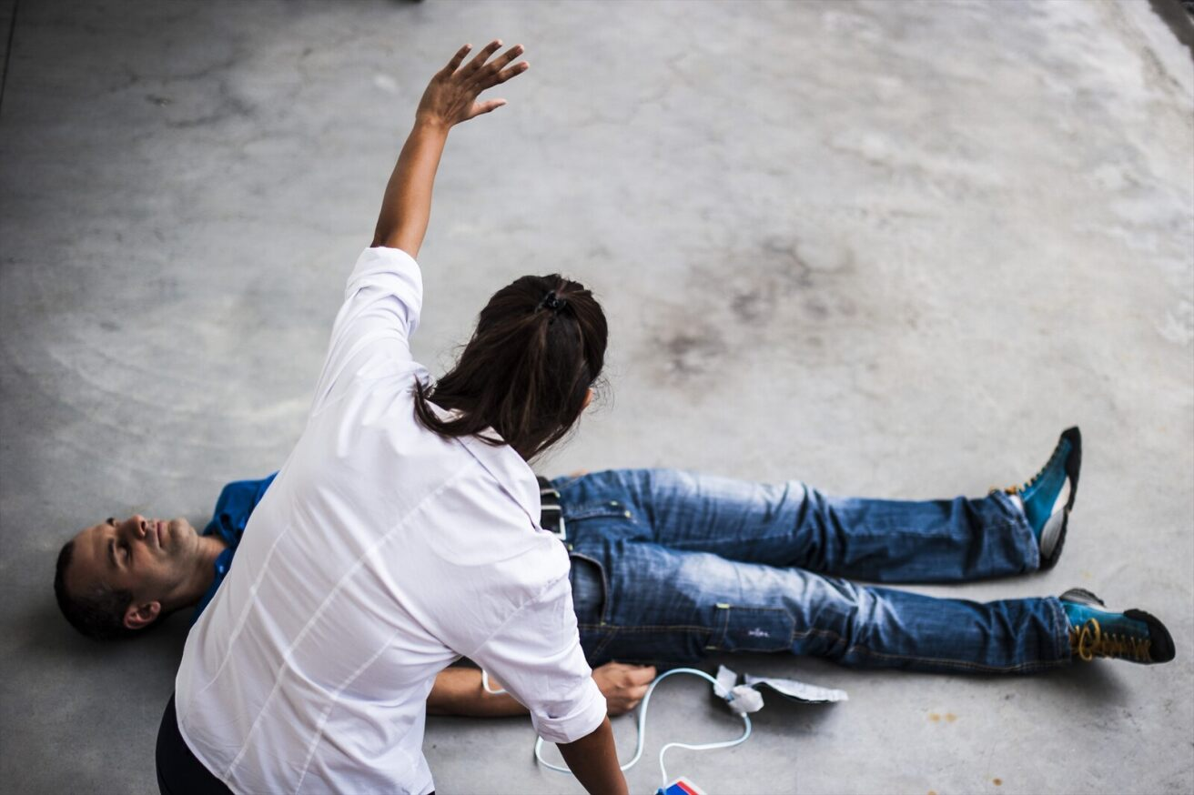
Workplace Violence Prevention Plan
Hazard assessment
Initial response
Response for injured people
Incident reporting
Incident investigation
Violent Incident Log
Work practices
Incident response
Training
Recordkeeping
Notes:
Our incident response procedure includes:
The initial response,
The response for injured people,
Incident reporting,
Incident investigation, and
The Violent Incident Log.
We will go over our incident response procedures in more detail later in the session.

Slide 11
Workplace Violence Prevention Plan
Hazard assessment
Report workplace violence
Recognize and respond to hazards
Identify potential hazards
Review security measures
Complete Violent Incident Log
Respond to aftermath
Work practices
Incident response
Training
Recordkeeping
Notes:
We provide workplace violence prevention training so that you can:
Report all workplace violence incidents, including threats and verbal abuse.
Recognize and respond to workplace security hazards, including strategies to avoid physical harm.
Identify potential workplace security hazards.
Review measures that have been put in place to prevent workplace violence, including:
The use of security equipment and procedures,
How to attempt to defuse hostile or threatening situations, and
How to summon assistance to prevent or respond to violence.
Complete the Violent Incident Log, and obtain copies of the log.
Respond and cope with the aftermath of a workplace violence incident, including medical follow-up and the availability of counseling and referral.
[Insert those who will need further training, such as supervisors and security personnel, and specialized training for employees whose role has some expectation for violence, if applicable.]
Training will be conducted annually. [Insert additional refresher training, if applicable.]
After completing the training, we will have time for any questions about your workplace violence concerns. We would also appreciate your feedback on this training session.

Slide 12
Workplace Violence Prevention Plan
Hazard assessment
Records of hazard assessments and workplace practices
Violent incident logs
Investigation reports
Work practices
Incident response
Training
Recordkeeping
Notes:
We will keep the following records for 5 years:
Records of workplace violence hazard assessments and workplace practices and procedures implemented to reduce the risk of workplace violence and injury to employees;
Violent incident logs; and
Workplace violence incident investigation reports.
Recordable injuries will also be included on our OSHA 300 logs.

Slide 13
4 Types of Workplace Violence
Type 1: Criminals, no business relationship
Type 2: Customers, clients, visitors
Type 3: Current or former employees
Type 4: Personal relationship to victim
Notes:
Workplace violence is generally classified into four types depending on who the perpetrator is.
Type 1 violence is committed by a person who has no legitimate business at the worksite and includes violent acts by anyone who enters the workplace or approaches workers with the intent to commit a crime.
Type 2 violence is directed at employees by customers, clients, students, inmates, or visitors.
Type 3 violence is committed against an employee by a present or former employee, supervisor, or manager.
Type 4 violence is committed by a person who does not work at the workplace but has or is known to have had a personal relationship with an employee.

Slide 14
Examples of Workplace Violence
Verbal threats
Aggressive behavior
Abusive language
Disorderly conduct
False statements
Weapons
Notes:
Examples of workplace violence include:
Verbal threats;
Aggressive behavior, like pushing or shoving;
Abusive or offensive language or gestures or other discourteous conduct;
Disorderly conduct, such as shouting, throwing objects, punching walls, and slamming doors;
Making false, malicious, or unfounded statements to damage someone’s reputation; or
Bringing weapons into the workplace.

Slide 15
Workplace Violence Risk Factors: Likelihood
Working with public
Working at night
Working alone
Working with violent people
Notes:
[Modify content and slide as appropriate for your facility.]
There are a number of factors that may impact the likelihood of a workplace violence incident. These include:
Working directly with the public
Working alone
Working at night
Working where alcohol is served
Mobile workplaces
Working with unstable or violent persons
Working in high-crime areas
Guarding valuable goods or property
Working in community-based settings

Slide 16
Workplace Violence Risk Factors: Severity
Inadequate security systems
Unrestricted movement of the public in a facility
Ineffective procedures to warn of danger
Blocked escape routes
Notes:
[Modify content and slide as appropriate for your facility.]
There are also factors that increase the severity of a workplace violence incident, including:
Inadequate security systems, such as a lack of door locks, entry codes or badge readers, security windows, physical barriers, and restraint systems;
Unrestricted movement of the public in a facility;
Ineffective systems and procedures that warn others of actual or potential workplace violence danger or that summon assistance, such as alarms or panic buttons;
Blocked escape routes;
No posting of emergency telephone numbers for law enforcement, fire, and medical services;
No access to a telephone with an outside line;
No designated safe area where employees can go in an emergency;
Employees’ lack of skill in safely handling threatening or hostile service recipients; and
A lack of communication between management and employees.

Slide 17
Controls, Work Practices, and Procedures
Engineering controls:
Security cameras
Locked doors and badges
Adequate lighting
Administrative controls:
Procedures for reporting problem behavior
Conflict resolution techniques
“Buddy" system
Notes:
Because of our specific risk factors of [list your facility’s risk factors], we have implemented the following controls, work practices, and procedures to reduce the risk of workplace violence at our facility:
[Modify content and slide as appropriate for your facility.]
Our engineering controls include:
Security cameras, silent alarms, and other security equipment;
Controlled access to the facility with locked doors and employee badges; and
Keeping the workplace well lit inside and outside.
Our administrative controls include:
Procedures for reporting problem behavior on the part of coworkers, customers, and others, which we will discuss later in this session;
Conflict resolution techniques, which we will also discuss later in this session; and
A “buddy" system for specified emergency events. [Explain buddy system, if applicable.]

Slide 18
Triggers of Workplace Violence: Employees (Work-related)
Layoffs, termination
Bad behavior report, poor performance
Conflicts with coworkers
Perceived unfairness
Notes:
Employee-related violence in the workplace occurs when someone reacts to a trigger in a violent manner. These triggers are often related to something going on in the workplace.
Here are some scenarios that may cause an employee to become violent:
When a business struggles and needs to lay off employees, those laid off can be angry, and some could react violently.
Likewise, employees who are fired for disciplinary or other reasons can also become violent—either at the time of firing or later.
Current employees who are warned about bad behavior may have a negative and violent reaction.
Employees receive a less-than-satisfactory performance review may take exception in a physical manner, as may some who do not receive a promotion or raise they expected.
Conflicts among employees can sometimes escalate into violent behavior. These may be related to the job or personal issues between individuals.
Perceived unfairness could also lead to violence in some situations—for example, if one employee was promoted over another who believed they deserved the promotion more. Either the promoted employee or the supervisor who did the promoting could be the target of violence.

Slide 19
Triggers of Workplace Violence: Employees (Personal life)
Domestic violence
Substance abuse
Untreated mental illness
Stressful life events
Notes:
Personal problems can also lead to violence at work.
This can include cases of domestic violence in which an abuser follows the employee to work and commits a violent act.
Employees with alcohol or drug problems can cause unsafe working conditions, as well as be more prone to violence.
In some cases, untreated mental illness can cause an individual to become violent in the workplace.
And, employees experiencing financial difficulties, divorce, health issues, or other stressful life events can sometimes react to that stress in a violent manner.
Often, violence is the result of several triggers at once. For example, an employee may be under stress at work, as well as at home.
However, it’s important to remember that most people experiencing stress or conflict at work or in their personal lives do not become violent. That’s why it’s important to pay attention to a person’s behavior, not only to the situations they are experiencing.

Slide 20
Triggers of Workplace Violence: Non-employees
Stressful situations
Substance abuse and mental illness
Other crimes
Random acts
Notes:
Violence perpetrated by people who are not employees can have some of the same triggering factors as violence committed by coworkers. In general, stressful and tense situations can be a trigger for violence. For example, a customer or client may react in a violent manner to a dispute. Just like with employees, stress and difficulties in a customer, client, or student’s work or personal life can spill over and lead to a violent outburst.
Substance abuse and untreated mental illness can also be connected to violence committed by people who are not employees.
Violence can also erupt during the course of other crimes, such as robberies or drug dealing, that can occur in parking areas, just outside your facility, or even inside the facility. If your job takes you on the road or to high-crime areas, you may be particularly susceptible to these types of incidents.
And, unfortunately, workplace violence is sometimes completely random, with no obvious reason or trigger.

Slide 21
Workplace Security: What You Can Do
Report suspicious activity
Make sure visitors sign in
Wear required ID
Use danger signal to alert others
Notes:
As an employee, there are security measures you can take to help prevent workplace violence [modify to your facility]:
Report to the proper authority any suspicious individuals or activity you see anywhere inside or outside the workplace.
Make sure visitors sign in and are escorted the entire time they’re on the premises.
Wear required identification, wherever appropriate, and require visitors to be properly identified.
Lock valuables, such as purses and wallets, in your desk or locker.
Report any security breaches, such as signs of a break-in or missing items, and cooperate with the investigation.
Use a prearranged danger signal [insert specific danger signal] to alert someone in your immediate vicinity of imminent danger.

Slide 22
Defusing Potentially Violent Situations
Remain calm
Show respect
Focus on problem
Alert a coworker
Notes:
Another way to prevent workplace violence and avoid physical harm is by defusing a potentially violent situation.
When you notice any signs of potential workplace violence, you should:
Remain calm, and continue to speak in a moderate tone of voice.
Show respect to people even when they become upset.
Focus on the problem by asking for details about the situation and going over possible solutions.
Alert a coworker or colleague with a prearranged danger signal [insert prearranged danger signal] if it is believed the person may become violent or the situation generates a sense of fear for personal safety or the safety of others. The coworker or colleague will immediately report to security and/or the police.
In the event of a workplace violence incident, you will be alerted to the presence, location, and nature of the workplace violence incident. [Insert the mechanism by which these alerts will be made at your facility or operation.]
If you feel uncomfortable initially addressing the potentially violent situation, immediately notify your supervisor. [Insert the way employees would notify the supervisor about the potentially violent situation.]

Slide 23
Levels of Violence and Response
Level 1
Behavior:
Bullying
Uncooperative
Verbally abusive
Response:
Calm attitude
Acknowledge feelings
Seek help if needed
Contact supervisor
Level 2
Behavior:
Argumentative
Damages equipment
Threatens to hurt employees
Response:
Secure your safety
Call 911 if warranted
Contact supervisor
Level 3
Behavior:
Suicidal threats
Physical fights
Use of weapons
Response:
Leave the area
Call 911
Contact supervisor
Notes:
Now, let’s discuss how to recognize the three levels of violence and how to respond to each level.
Level 1, or early warning signs, is when the person is:
Intimidating or bullying
Discourteous or disrespectful
Uncooperative
Verbally abusive
When someone exhibits level 1 behavior, maintain a calm attitude; acknowledge the person’s feelings— for example, “I know you are frustrated”; and avoid acting in a manner that could be interpreted as aggressive—for example, moving quickly, getting too close, or speaking loudly. Always report concerns to your supervisor, and seek the supervisor’s help in responding to the situation if needed.
Level 2, or when the situation escalates, is when the person:
Argues with customers, vendors, employees, and/or management;
Refuses to obey company policies and procedures;
Damages equipment and steals property;
Verbalizes wishes to hurt employees and/or management;
Sends a threatening note(s) to an employee(s) and/or management; and/or
Sees self as victimized by management.
When someone exhibits level 2 behavior, call 911 if warranted, particularly if the situation requires immediate medical and/or law enforcement personnel. If necessary, secure your own safety and the safety of others. Then, contact your supervisor to report the violent behavior.
Level 3, or imminent violence, is when the person displays intense anger, resulting in:
Suicidal threats
Physical fights
Destruction of property
Display of extreme rage
Use of weapons to harm others
When someone exhibits level 3 behavior, immediately leave the area and call 911. Remain calm, and contact your supervisor. Cooperate with law enforcement personnel when they respond to the situation.

Slide 24
Active Shooter Situations
Motivated by different causes
No pattern to selection
Unpredictable
Escalate quickly
Notes:
Active shooter situations are a particular type of workplace violence in which one or more individuals are actively engaged in killing or attempting to kill people in a confined space or another populated area with the use of firearms.
Active shooters may be motivated by many different causes, including anger, revenge, or ideology.
In most cases, there is no pattern or method to an active shooter’s selection of victims.
Active shooter events are unpredictable. They happen quickly, and they escalate quickly. Sometimes, they are over before law enforcement can respond.

Slide 25
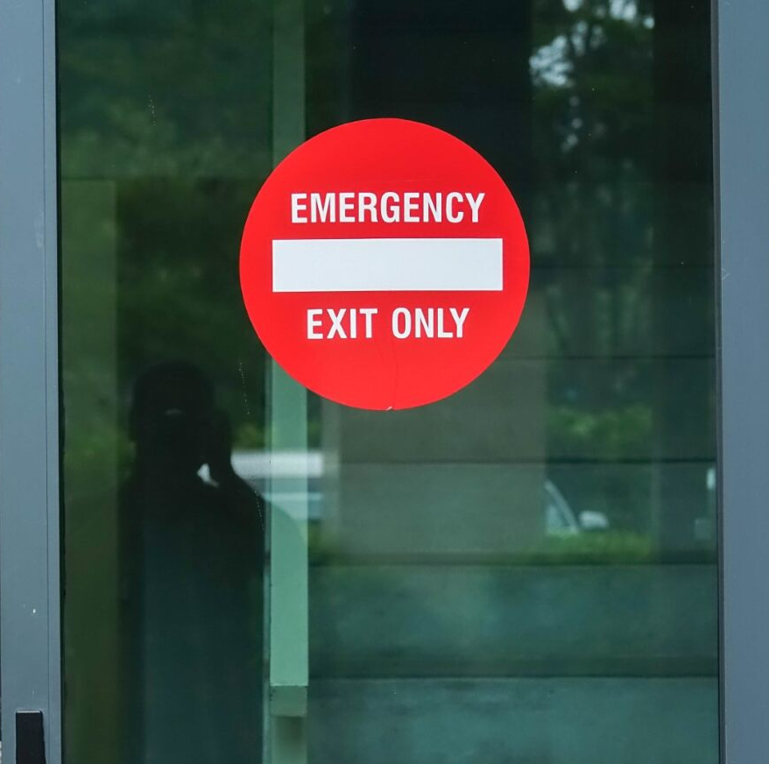
Active Shooter Response
Escape to safety, then call 911
Hide and barricade
Confront shooter as last resort
Cooperate with law enforcement
Notes:
Knowing how to react to protect your personal safety if you are ever in an active shooter situation can help you survive:
Your first course of action should be to escape to safety. Make sure you know your nearest exit routes and how to get out quickly. Don’t stop to gather your belongings. Encourage other people to come with you, but if they are reluctant, don’t let them stop you from leaving. Once you are in a safe location, call 911.
If you can’t escape safely, the next-best option is to hide. When you choose a hiding place, make sure it is out of the shooter’s view. Try to barricade yourself in your hiding place by locking doors, moving furniture, and placing other obstacles between you and the shooter. Close, lock, and move away from windows. Remain quiet and make sure your cellphone is silenced until the danger is gone.
As a last resort, you may need to take action if confronted face-to-face with an active shooter. Your goal is to disrupt, distract, or incapacitate the attacker. You can improvise weapons, such as a fire extinguisher, heavy furniture, or anything else you have at your disposal. Commit to stopping the shooter by any means necessary.
When law enforcement arrives, their first goal is to stop the shooter. They will not stop to tend to victims until the area is safe. You can help law enforcement people do their job by keeping your hands visible at all times, remaining calm, and following any instructions you are given. Avoid making sudden movements, screaming, or pointing.
We will rehearse active shooter drills [insert frequency of active shooter drills, if applicable].

Slide 26
Evacuation
Recognize evacuation signal
Listen for instructions
Follow exit route
Go to meeting area
Notes:
Under certain circumstances involving workplace violence, you may be directed to evacuate the facility.
If full evacuation of the building becomes necessary [modify to your facility]:
Recognize what the evacuation alarm sounds or looks like. [Describe your facility’s alarm sounds.]
Listen to and follow any instructions that are given, whether over a public address system or in person, including which sections of the building may be unsafe to exit through and where the designated meeting area is.
Follow the quickest exit route out of the building.
Go immediately to the designated meeting area.
We will rehearse evacuation drills [insert frequency of evacuation drills].

Slide 27
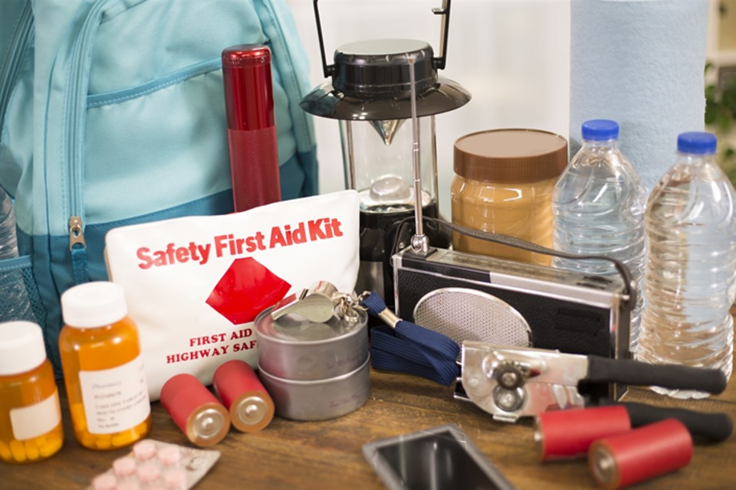
Shelter-in-Place
Locate emergency kit
Go to sheltering room
Shut windows and doors
Seal windows, doors, vents
Wait for further instructions
Notes:
In other situations, you may be required to stay at work and shelter in place. In that case, [modify to your facility]:
Locate the emergency kit.
Go to the sheltering room, and bring the emergency kit with you if it’s not already stored there.
Shut windows and doors to the sheltering room.
After everyone arrives, seal windows, doors, and vents with duct tape in the case of a chemical attack threat.
Finally, listen to the radio for news on the situation, further instructions, and the all-clear signal.
We will rehearse shelter-in-place drills [insert frequency of shelter-in-place drills].

Slide 28
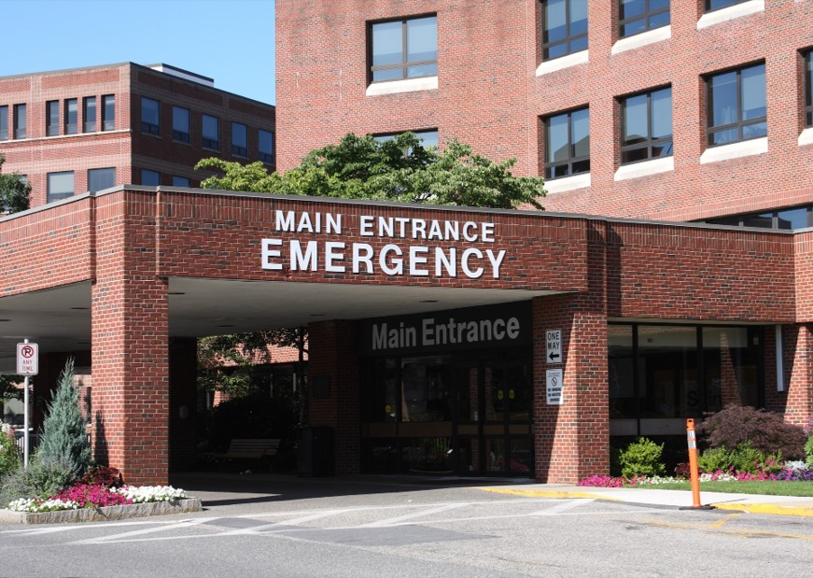
Responding to Injuries
Contact emergency services
Report incident
Secure area
Prepare Violent Incident Log
Affected employees provided with counseling
Notes:
In the event of a workplace violence incident that results in someone being injured:
If you witness an attack resulting in an injury that requires more than first aid, immediately contact emergency services. Injured people will receive prompt and appropriate medical care. They’ll be transported to medical care facilities.
The incident will be reported to police and other authorities as required by law.
The area where the violent actions occurred will be secured to protect evidence and minimize any disturbance during the post-incident response process.
An incident investigation will be conducted.
Injured people, witnesses to the incident, and other affected employees will be provided psychological assistance and counseling to reduce trauma and stress.
We’ll discuss more of how to deal with the psychological effects that may occur after a workplace violence incident later in the session.

Slide 29
Reporting Workplace Violence Incidents
Report all incidents immediately
No retaliation for reporting
Supervisor will inform plan administrator
Notes:
You must report all workplace violence incidents and threats to your supervisor immediately. You can report violent activity without fear of retaliation. We do not discriminate against victims of workplace violence. Your supervisor will inform the plan administrator about the incident or threat. [Insert descriptions of the mechanisms to complete such reporting within your facility or operation.]

Slide 30
Violent Incident Log
Date, time, location
Workplace violence type
Description of incident
Who committed violence
Circumstances
Type of incident
Consequences
Person completing log
Notes:
As part of the investigation for an incident of workplace violence, the plan administrator will complete the Violent Incident Log, which includes the following information:
Date, time, and location of the incident;
Workplace violence type(s) (i.e., Type 1 violence, Type 2 violence, Type 3 violence, or Type 4 violence);
Detailed description of the incident;
Classification of who committed the violence (e.g., client, customer, family, friend, stranger, supervisor, etc.);
Classification of circumstances at the time of the incident (e.g., whether the employee was completing usual job duties, working in a poorly lit area, rushed, working alone, etc.);
A classification of where the incident occurred (e.g., in the workplace, parking lot, or another area outside the workplace);
The type of incident, including, but not limited to, whether it involved any of the following:
Physical attack without a weapon, including, but not limited to, biting, choking, grabbing, hair pulling, kicking, punching, slapping, pushing, pulling, scratching, or spitting;
Attack with a weapon or an object, including, but not limited to, a firearm, a knife, or another object;
Threat of physical force or threat of the use of a weapon or another object;
Sexual assault or threat, including, but not limited to, rape, attempted rape, physical display, or unwanted verbal or physical sexual contact;
Animal attack; or
Another form of workplace violence.
Consequences of the incident, including, but not limited to, whether security or law enforcement was contacted and any actions taken to protect employees from a continuing threat or from any other hazards identified as a result of the incident; and
Information about the person completing the log (name, job title, date of log entry).
The information recorded in the Violent Incident Log will be based on information obtained from the employees who experienced the workplace violence, on witness statements, and on investigation findings. Any identifying information about any person involved in a violent incident will not be included in the Violent Incident Log.
You can access copies of the log by [insert way employees access log].

Slide 31
Investigation
Comply with investigation
Evaluation report
Recommendations to prevent incidents
Corrective actions
Notes:
After a workplace violence incident, the plan administrator will investigate the incident. You must comply with all aspects of the investigation. [Insert description(s) of incident investigation techniques applicable to your facility or operation.]
The plan administrator will write an evaluation report of the incident and will make recommendations to prevent similar incidents from occurring, including revisions to the Workplace Violence Prevention Plan.
The plan administrator will tell you the corrective actions taken as a result of the incident investigation. [Insert mechanism to inform employees of the results of the investigation and the corrective actions that will be implemented as a result of the recommendation in the report.]

Slide 32
Aftermath of Workplace Violence
Signs of distress:
Withdrawing from peers
Calling in sick or overworking
Difficulty concentrating
Ways to cope:
Talk about incident
Spend extra time with loved ones
Turn off media coverage
Notes:
As previously mentioned, after an incident of workplace violence, all affected employees will be provided psychological assistance and counseling to reduce trauma and stress.
Look for these signs of distress in yourself and your coworkers:
Withdrawing from work activity or peers or appearing emotionless;
Frequently calling in sick, overworking, or working slowly; and
Difficulty concentrating, making decisions, or dealing with change.
In addition to counseling, there are other ways to cope with distress and to help others cope:
Talk about the incident with coworkers and supervisors.
Spend extra time with loved ones.
Turn off media coverage about the event, and don’t read about it.

Slide 33
Questions/Feedback
Notes:
[This slide gives trainees the opportunity to ask questions about the content in the training and to provide feedback on how the training might be improved.]

Slide 34
Key Points to Remember
Types: 1—criminals, 2—customers/clients, 3—employees, 4—personal to victim
Risk factors: high likelihood—working with public, alone, at night; increased severity—inadequate security, unrestricted movement, ineffective warning procedures
Controls: security cameras, alarms, controlled access, adequate lighting, reporting behavior, conflict resolution techniques, “buddy” system
Signs: bullying, disrespectful, uncooperative, and/or verbally abusive; escalation: argumentative, steals property, threats
Defuse: remain calm, show respect, focus on problem
Respond: leave area, call 911, report, cooperate with investigation, Violent Incident Log, receive counseling
Notes:
Here are the main points to remember this session:
The four types of workplace violence are Type 1, which is committed by a person who has no legitimate business at the worksite and who has the intent to commit a crime; Type 2, which is directed at employees by customers, clients, students, inmates, or visitors; Type 3, which is committed against an employee by a present or former employee, supervisor, or manager; and Type 4 , which is committed by a person who does not work at the workplace but has or is known to have had a personal relationship with an employee.
The factors that increase the likelihood of workplace violence include working with the public, working at night, working alone, and working with violent people. The factors that increase the severity of a workplace violence incident include inadequate security systems, unrestricted movement of the public in the facility, ineffective procedures to warn of danger, and blocked escape routes.
The engineering controls we have at our facility include [modify to your facility]: security cameras, silent alarms, and other security equipment; controlled access to the facility with locked doors and employee badges; and keeping the workplace well lit inside and outside. The administrative controls we have include [modify to your facility]: procedures for reporting problem behavior on the part of coworkers, customers, and others; conflict resolution techniques, and the “buddy" system for specified emergency events.
Early signs of potential violence is a person who is bullying, disrespectful, uncooperative, and/or verbally abusive. Signs of escalation include a person who is argumentative, damages equipment and steals property, and/or verbalizes wishes to hurt employees.
If the situation has not escalated, you can defuse potentially violent situations safely by remaining calm and continuing to speak in a moderate tone of voice; showing respect to people even when they become upset; focusing on the problem by asking for details about the situation and going over possible solutions; and alerting a coworker with a prearranged danger signal if it is believed the person may become violent or the situation generates a sense of fear for personal safety or the safety of others.
If you are in a violent situation, immediately leave the area, and call 911. Remain calm, and contact your supervisor to report the situation. In the event of an active shooter situation, run and escape as your first action. If you can’t evacuate, hide in a locked room. If you are confronted with the shooter, try to disrupt, distract, or incapacitate the attacker. You can improvise weapons, such as a fire extinguisher. Cooperate with law enforcement personnel when they respond to the situation. After the violent incident is over, you must cooperate with the incident investigation conducted by the plan administrator, which includes completing the Violent Incident Log. We will provide affected employees with psychological assistance and counseling to reduce trauma and stress.

